Slide 1
Advanced Java (MCPCC2014)
Dr. Shital Joshi-Advant
Expert Lecturer
Department of MCA
Government Engineering College Aurangabad
Chh. Sambhajinagar

Slide 2
UNIT I : Introduction to Networking and RMI
Basics of Networking
Overview of the OSI model
Socket programming
Client Socket And Server Socket
Multicast Socket
RMI: Introduction to Distributed Computing
RPC
Introduction to RMI
Stubs and Skeletons
The process of Creating a Simple RMI Application

Slide 3
Practical based on Unit 1
Write a program for creating mini chat application using socket programming.
Write a program for Addition and Subtraction Using concept of RMI programming.

Slide 4
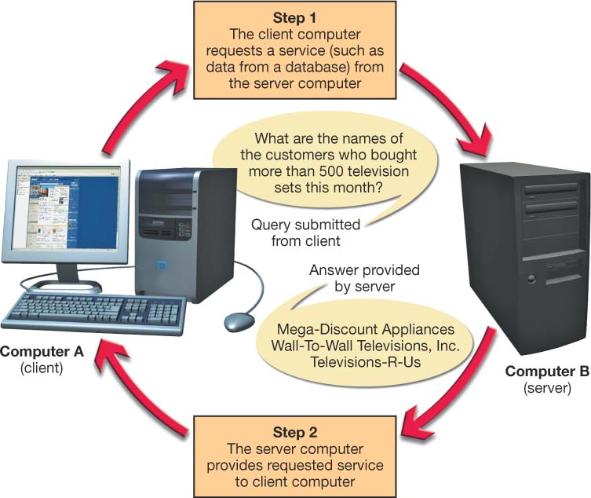
Client/Server Networks
Server-based network
Clients and servers
Data flows efficiently
Servers respond to requests from clients
Servers perform specific tasks
Scalable network
Centralized
Notes:
To review, a server is a computer that both stores and shares resources on a network, whereas a client is a computer that requests those resources.
A client/server network contains servers as well as client computers. The inclusion of servers is what differentiates a client/server network from a typical peer-to-peer (P2P) network.
The main advantage of a client/server relationship is that it makes data flow more efficiently than in peer-to-peer networks. Servers can respond to requests from a large number of clients at the same time.
Also, servers are configured to perform specific tasks (such as handling e-mail or database requests) efficiently.
Client/server networks are also scalable network, meaning additional users can be added easily without affecting the performance of the other network nodes.
In addition, whereas P2P networks are decentralized (users are responsible for creating their own data backups and for providing security for their computer), client/server networks are centralized, meaning all clients connect to a server that performs tasks for them.

Slide 5
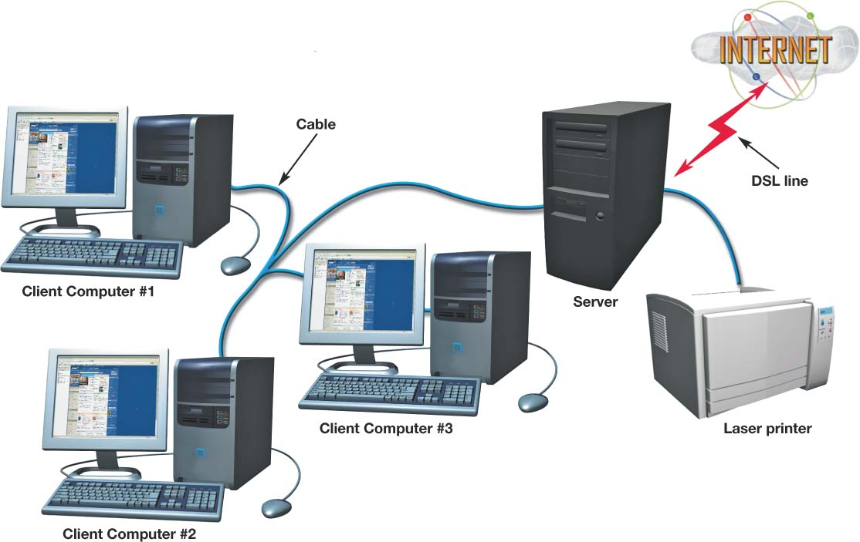
Classifications of Client/Server Networks
LAN
Local area network
Computers linked together over a small geographic region
Notes:
Local area networks (LANs) are generally smaller groups of computers and peripherals linked together over a relatively small geographic area.
The computer lab at your school or the network on the floor of the office where you work is probably a LAN..

Slide 6
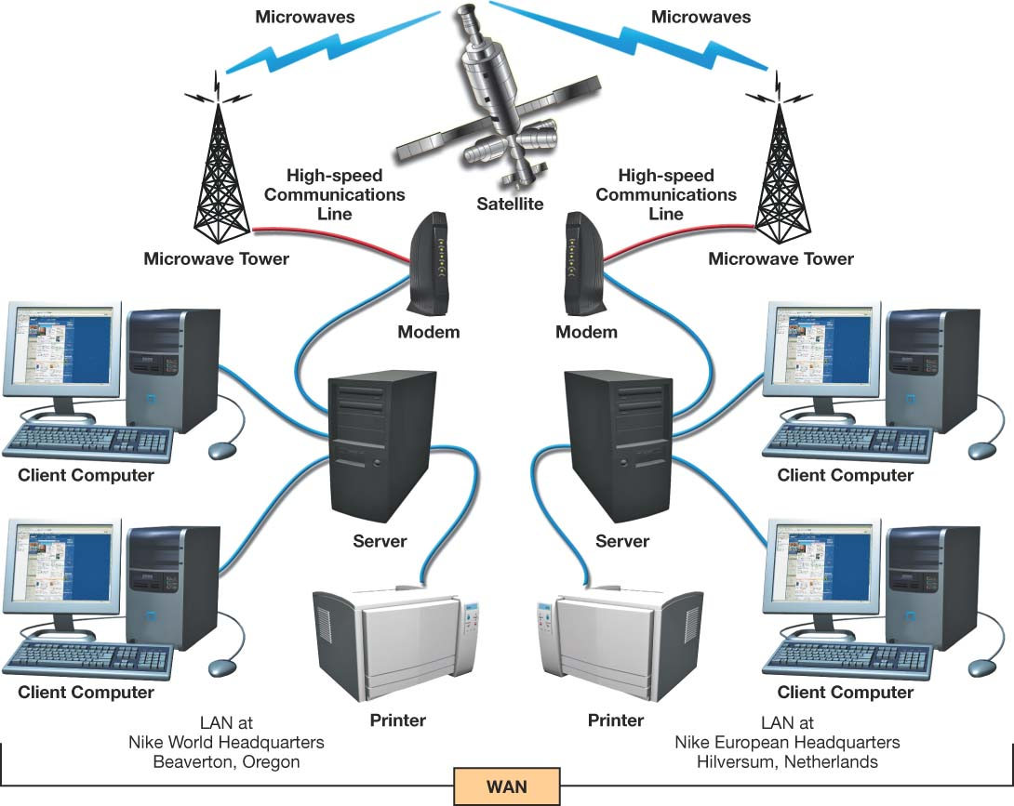
Classifications of Client/Server Networks
WAN
Wide area network
Computers linked over large geographic locations
MAN
Metropolitan area network
Computers linked together within a city or county
Notes:
For large companies that operate at diverse geographic locations, a LAN is not sufficient for meeting their computing needs. Wide area networks (WANs) comprise large numbers of users or separate LANs that are miles apart and linked together. Corporations often use WANs to connect two or more geographically diverse branches.
Sometimes government organizations or civic groups establish WANs to link users in a specific geographic area (such as within a city or county). These special type of WANs are known as metropolitan area networks (MANs).

Slide 7
Classifications of Client/Server Networks
PAN
Personal area network
Wireless devices connected in close proximity to each other
Intranet
Private corporate network
Protected by a firewall
Notes:
Personal area networks (PANs) are used to connect wireless devices (such as Bluetooth-enabled devices) in close proximity to each other. PANs are wireless and operate in the personal operating space of an individual, which is generally defined to be within 30 feet of your body.
An intranet is a private corporate network that is used exclusively by company employees to facilitate information sharing, database access, group scheduling, videoconferencing, or other employee collaboration. The intranet is not accessible to non-employees; a firewall protects it from the Internet.

Slide 8
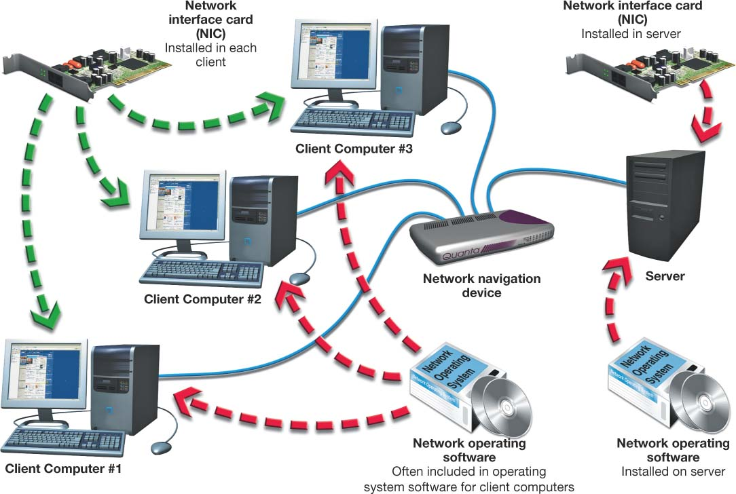
Constructing Client/Server Networks
Servers
Network topologies
Transmission media
Network operating system (NOS)
Network adapters
Network navigation devices
Notes:
Client/server networks share many of the same components of P2P networks as well as some components specific to client/server networks:
- Server. Unlike P2P networks, client/server networks contain at least one computer that functions solely as a server.
- Network topology. Because client/server networks are more complex than P2P networks, the layout and structure of the network must be carefully planned.
- Transmission media. Transmission media (cable or wireless communications technology) is needed based on the network topology. Client/server networks use a wider variety of cable types than do simpler P2P networks.
- Network operating system (NOS) software. All client/server networks require network operating system (NOS) software, which is specialized software that is installed on servers and client computers that enables the network to function.
- Network adapters. Network adapters (or network interface cards) are attached or installed to each device on a client/server network. These adapters enable the computer (or peripheral) to communicate with the network using a common data communication language, or protocol.
- Network navigation devices. Because of the complexity of a client/server network, specialized network navigation devices (such as routers, hubs, and switches) are needed to move data signals around the network.

Slide 9
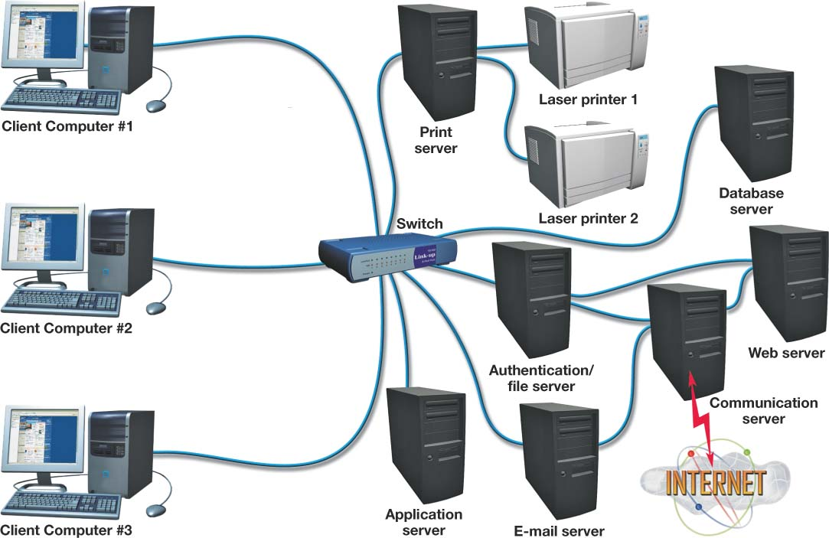
Servers
Number and type of servers depend on network size and workload
Dedicated server
Performs one specific function
Authentication server
Keeps track of network logins and services available
File server
Stores and manages files
Notes:
Servers are the workhorses of the client/server network. They serve many different network users and assist them with accomplishing a variety of tasks.
The number and types of servers on a client/server network depend on the network’s size and workload.
As more users are added to a network, dedicated servers are used to fulfill one specific function (such as handling e-mail). When dedicated servers are deployed, the main server then becomes merely an authentication server and/or a file server.
Authentication servers keep track of who is logging on to the network and which services on the network are available to each user. Authentication servers also act as overseers for the network. They manage and coordinate the services provided by any other dedicated servers located on the network.
File servers store and manage files for network users. On corporate networks, employees are provided with space on a file server to store files they create.

Slide 10
Dedicated Servers
Print server
Manages client-requested printing jobs
Creates print queue (prioritizes print jobs)
Applications server
Acts as a storage area for application software
Database server
Provides clients with access to database information
E-mail server
Processes and delivers in-coming and outgoing e-mail
Notes:
Any task that is repetitive or demands a lot of time of the server’s processor (CPU) is a good candidate to relegate to a dedicated server.
A network with a centralized printing service will have a print server that routes print jobs to appropriate devices and prioritizes printing according to order of request, unless overridden by special needs.
Application servers store and distribute as needed a set of application software for each system on the network. In these configurations, upgrades and new software installs are done just once on this server rather than deploying the programs throughout the organization.
Database servers are dedicated to an organization’s database storage, queries, and retrievals.
In large organizations e-mail servers handle the large volume of incoming, outgoing, and internal e-mail.

Slide 11
Dedicated Servers
Communications server
Handles communications between networks including the Internet
Often the only device on the network directly connected to the Internet
Web server
Hosts a Web site available through the Internet
Notes:
A communications server handles all communications between the network and other networks, including managing Internet connectivity. All requests for information from the Internet and all messages being sent through the Internet pass through the communications server.
Often, the communications server is the only device on the network connected to the Internet. E-mail servers, Web servers, and other devices needing to communicate with the Internet usually route all their traffic through the communications server. Providing a single point of contact with the outside world makes it easier to secure the network from hackers.
A Web server is used to host a Web site available through the Internet. Web servers run specialized software that enables them to host Web pages.

Slide 12
P2P Networking/Computing
P2P computing is the sharing of computer resources and services by direct exchange between systems.
These resources and services include the exchange of information, processing cycles, cache storage, and disk storage for files.
P2P computing takes advantage of existing computing power, computer storage and networking connectivity, allowing users to leverage their collective power to the “benefit” of all.

Slide 13
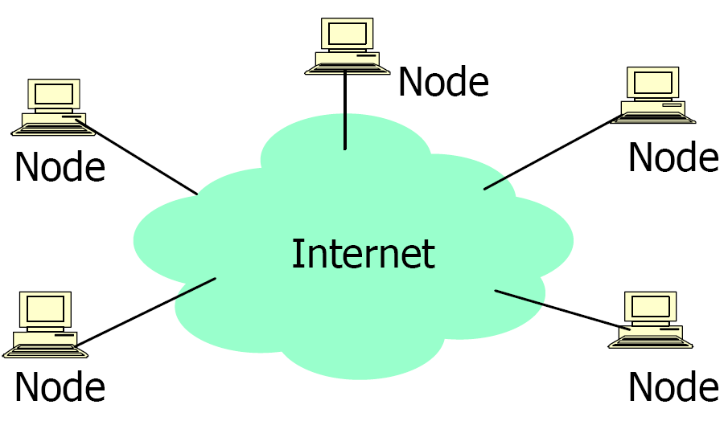
P2P Architecture
All nodes are both clients and servers
Provide and consume data
Any node can initiate a connection
No centralized data source
“The ultimate form of democracy on the Internet”
“The ultimate threat to copy-right protection on the Internet

Slide 14
What is P2P?
A distributed system architecture
No centralized control
Typically many nodes, but unreliable and heterogeneous
Nodes are symmetric in function
Take advantage of distributed, shared resources (bandwidth, CPU, storage) on peer-nodes
Fault-tolerant, self-organizing
Operate in dynamic environment, frequent join and leave is the norm
Internet

Slide 15
P2P Network Characteristics
Clients are also servers and routers
Nodes contribute content, storage, memory, CPU
Nodes are autonomous (no administrative
authority)
Network is dynamic: nodes enter and leave the network “frequently”
Nodes collaborate directly with each other (not through well-known servers)
Nodes have widely varying capabilities

Slide 16
P2P vs. Client/Server
Pure P2P:
No central server
For certain requests any peer can function as a client, as a router, or as a server
The information is not located in a central location but is distributed among all peers
A peer may need to communicate with multiple peers to locate a piece of information
As more peers are added, both demand
and capacity of the network increases !

Slide 17
P2P Benefits
Efficient use of resources
Unused bandwidth, storage, processing power at the edge of the network
Scalability
Consumers of resources also donate resources
Aggregate resources grow naturally with utilization
Reliability
Replicas
Geographic distribution
No single point of failure
Ease of administration
Nodes self organize
No need to deploy servers to satisfy demand (c.f. scalability)
Built-in fault tolerance, replication, and load balancing

Slide 18
Difference between Client-Server and Peer-to-Peer Network:
S.NO | CLIENT-SERVER NETWORK | PEER-TO-PEER NETWORK
1. | In Client-Server Network, Clients and server are differentiated, Specific server and clients are present. | In Peer-to-Peer Network, Clients and server are not differentiated.
2. | Client-Server Network focuses on information sharing. | While Peer-to-Peer Network focuses on connectivity.
3. | In Client-Server Network, Centralized server is used to store the data. | While in Peer-to-Peer Network, Each peer has its own data.
4. | In Client-Server Network, Server respond the services which is request by Client. | While in Peer-to-Peer Network, Each and every node can do both request and respond for the services.
5. | Client-Server Network are costlier than Peer-to-Peer Network. | While Peer-to-Peer Network are less costlier than Client-Server Network.
6. | Client-Server Network are more stable than Peer-to-Peer Network. | While Peer-to-Peer Network are less stable if number of peer is increase.
7. | Client-Server Network is used for both small and large networks. | While Peer-to-Peer Network is generally suited for small networks with fewer than 10 computers

Slide 19
THE OSI MODEL
Established in 1947, the International Standards Organization (ISO) is a multinational body dedicated to worldwide agreement on international standards. An ISO standard that covers all aspects of network communications is the Open Systems Interconnection (OSI) model. It was first introduced in the late 1970s.

Slide 20

Note
ISO is the organization. OSI is the model.

Slide 21
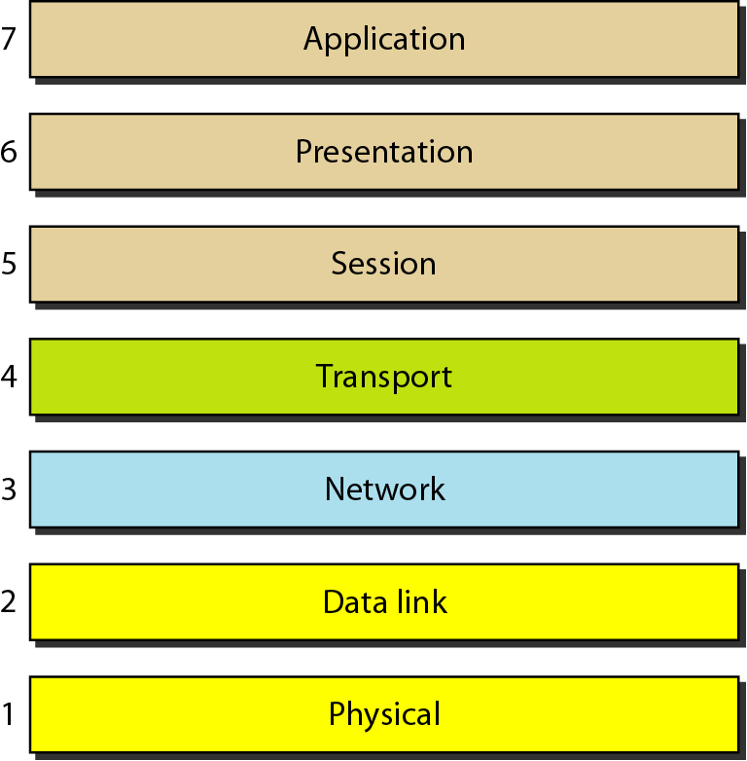
Figure 1.1 Seven layers of the OSI model

Slide 22
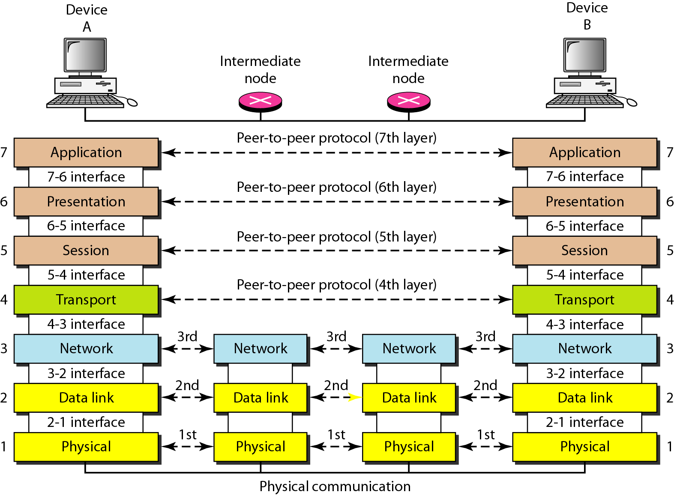
Figure 1.2 The interaction between layers in the OSI model

Slide 23
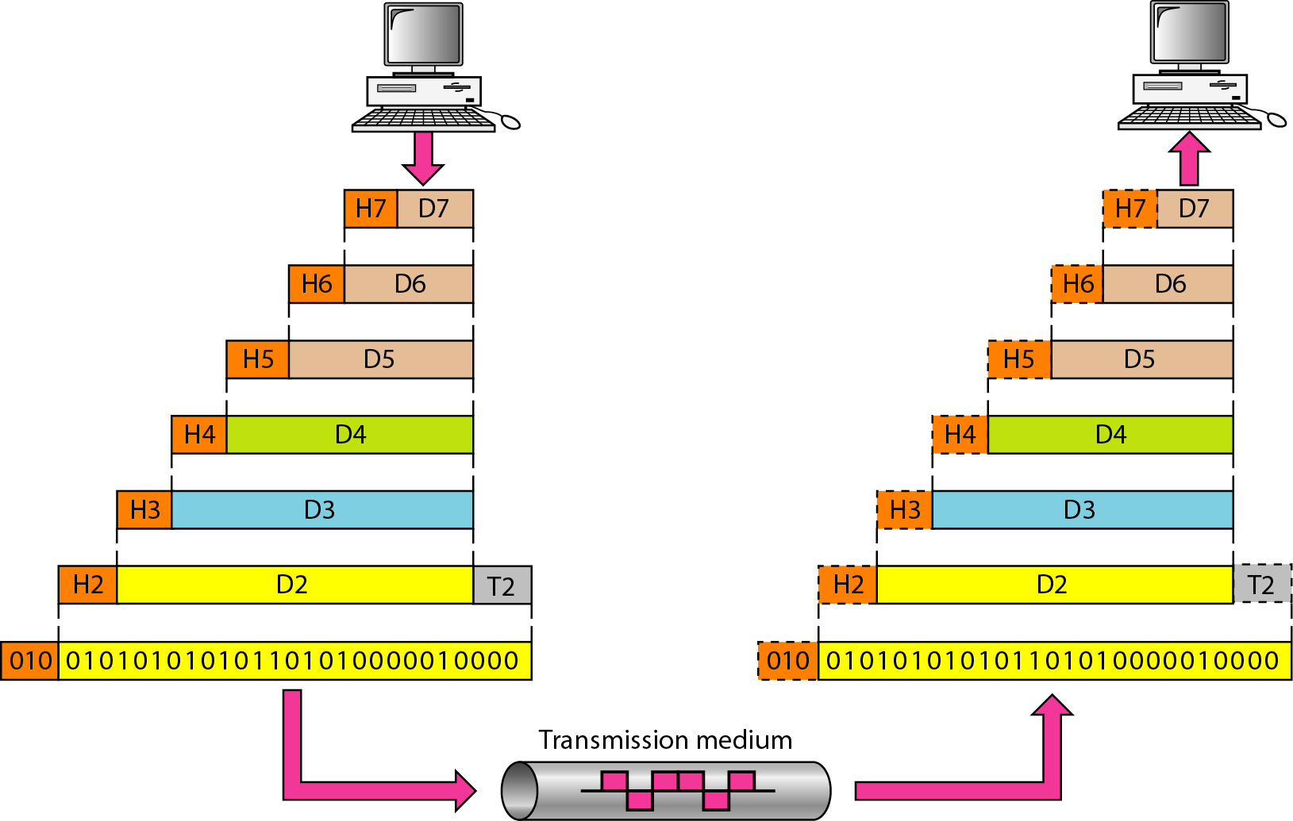
Figure 1.3 An exchange using the OSI model

Slide 24
LAYERS IN THE OSI MODEL
In this section we briefly describe the functions of each layer in the OSI model.

Slide 25
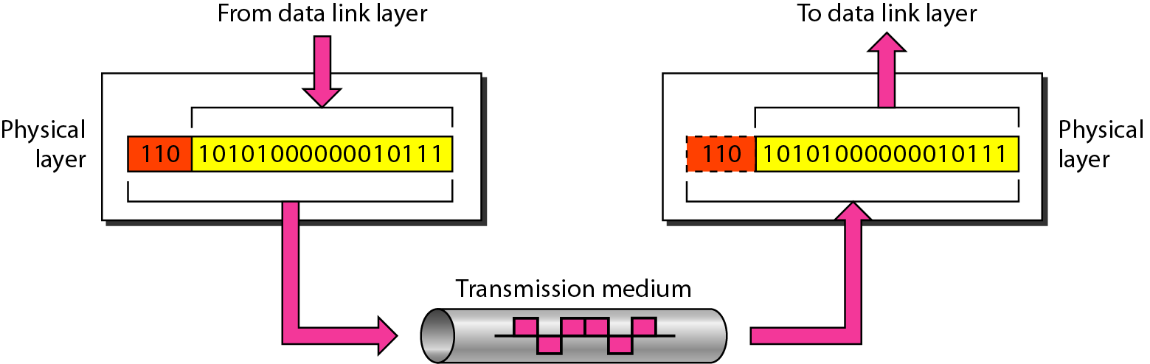
Figure 1.4 Physical layer

Slide 26
Note
The physical layer is responsible for movements of
individual bits from one hop (node) to the next.

Slide 27
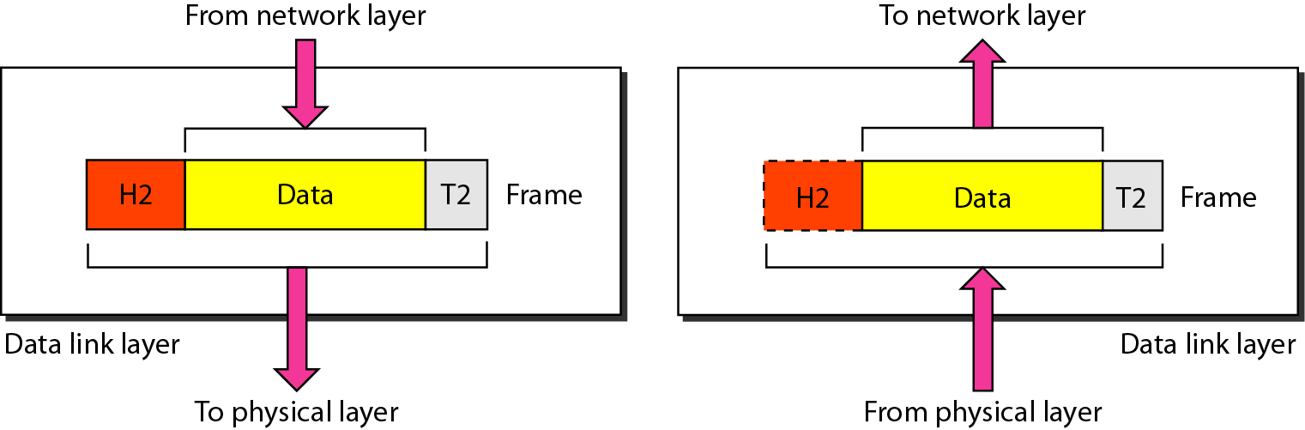
Figure 1.5 Data link layer

Slide 28
Note
The data link layer is responsible for moving frames from one hop (node) to the next.

Slide 29
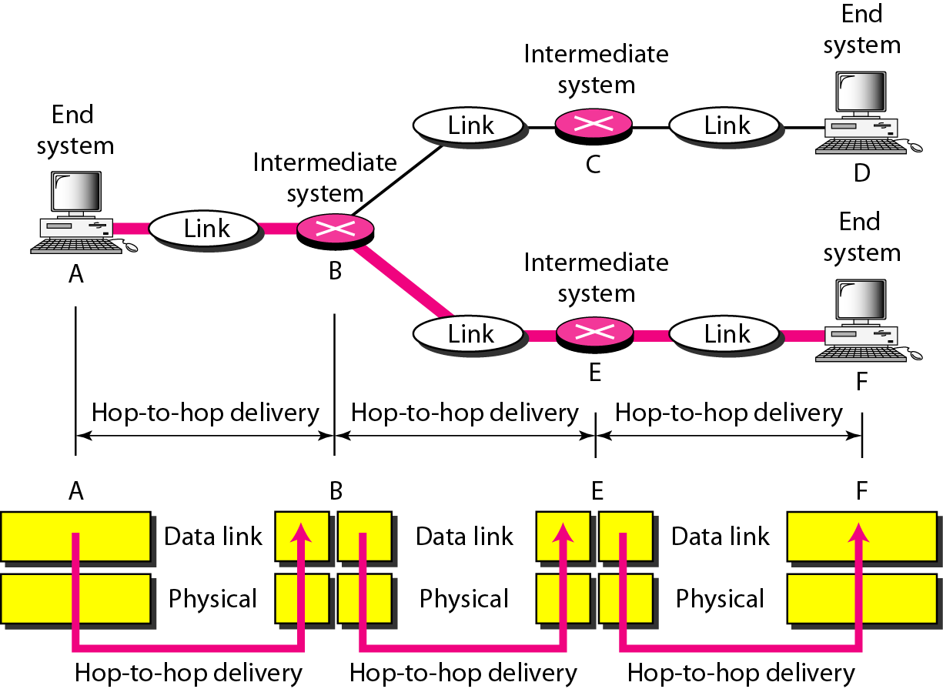
Figure 1.6 Hop-to-hop delivery

Slide 30
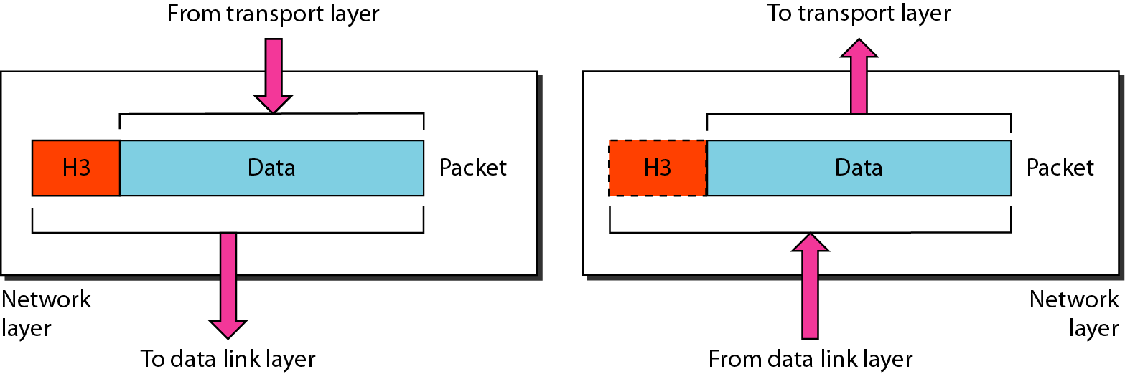
Figure 1.7 Network layer

Slide 31
Note
The network layer is responsible for the delivery of individual packets from
the source host to the destination host.

Slide 32
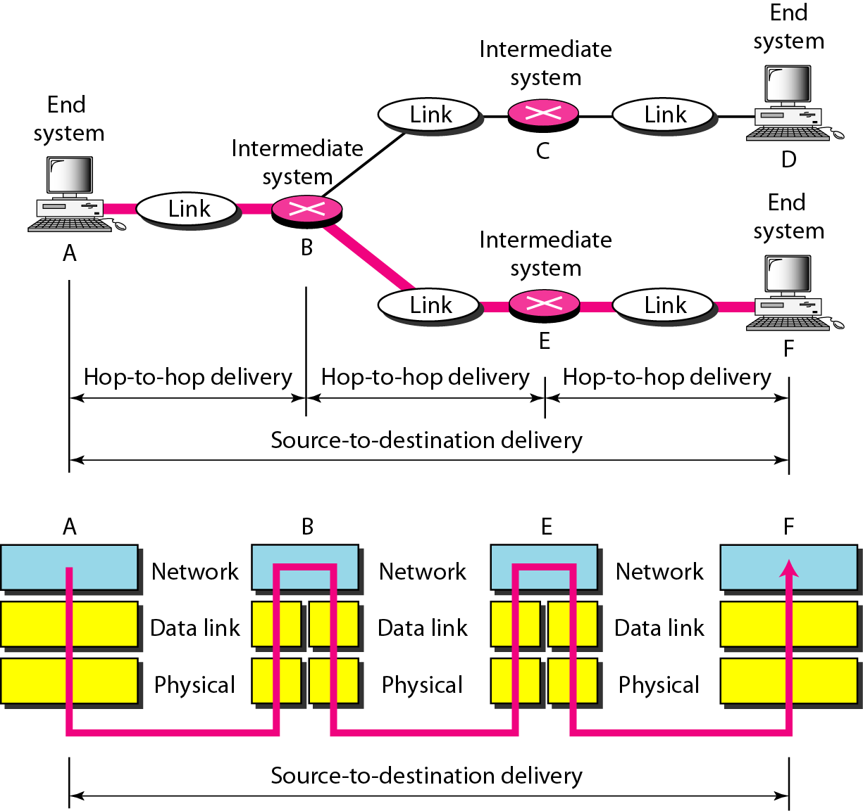
Figure 1.8 Source-to-destination delivery

Slide 33
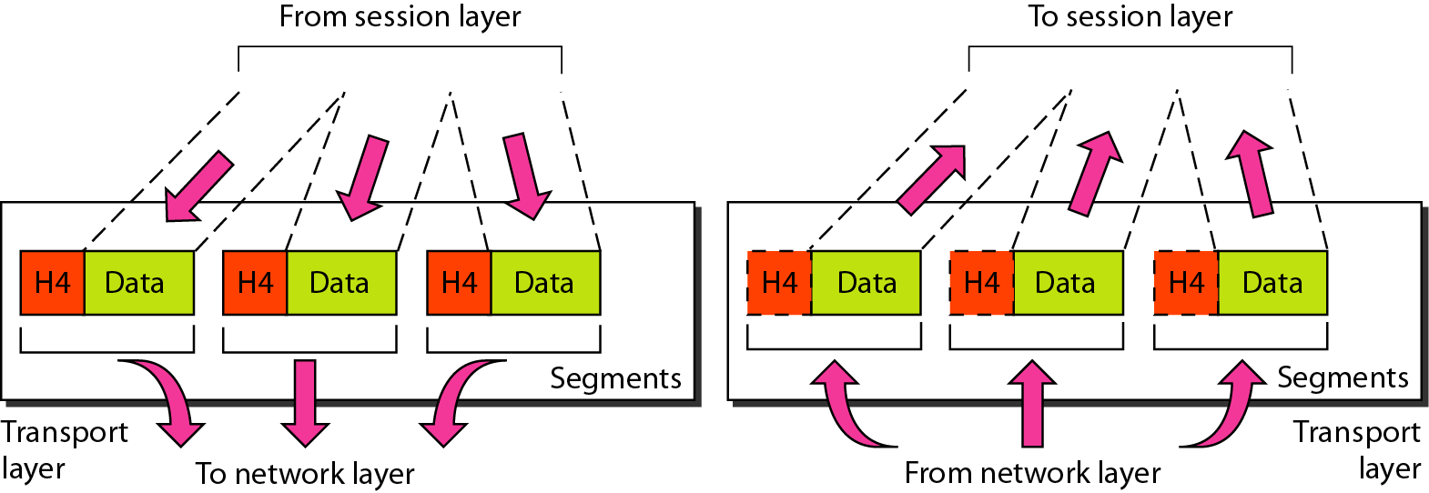
Figure 1.9 Transport layer

Slide 34
Note
The transport layer is responsible for the delivery of a message from one process to another.

Slide 35
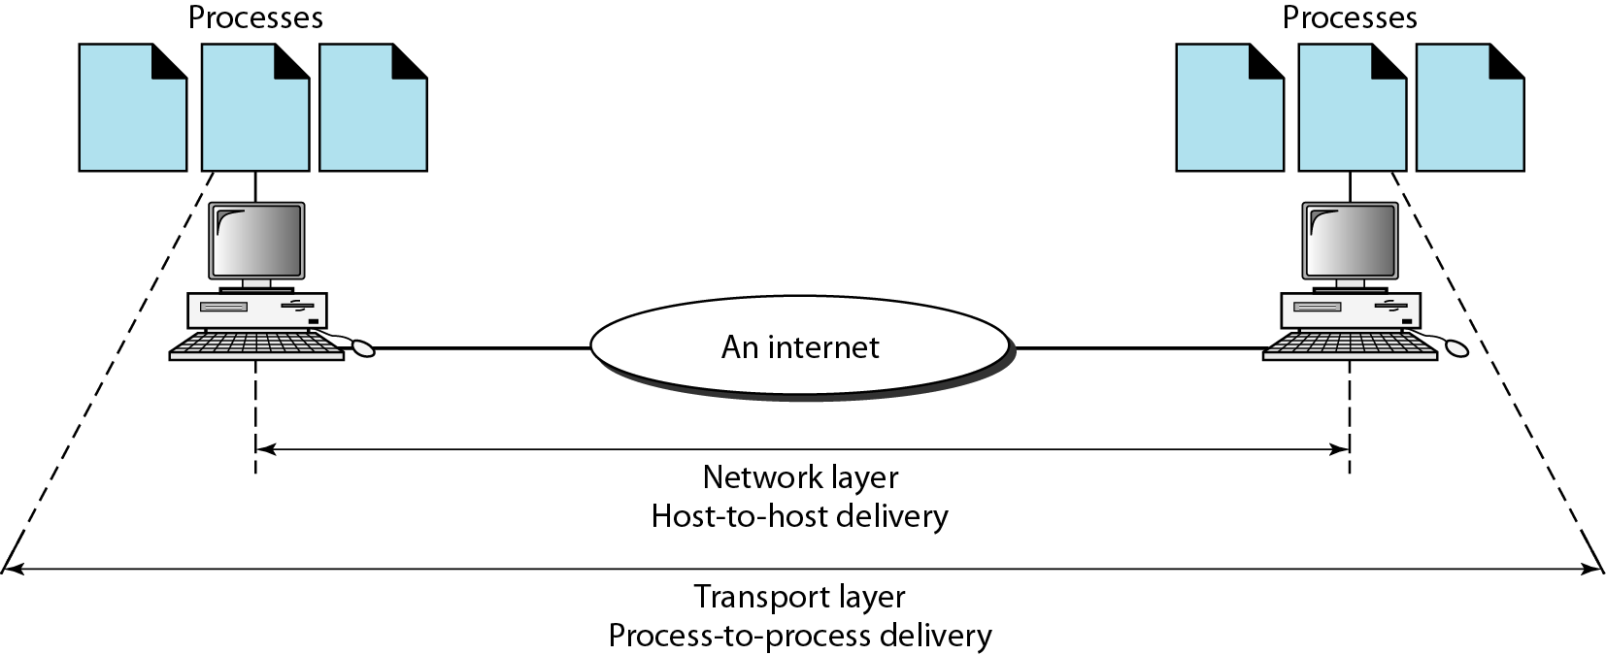
Figure 1.10 Reliable process-to-process delivery of a message

Slide 36
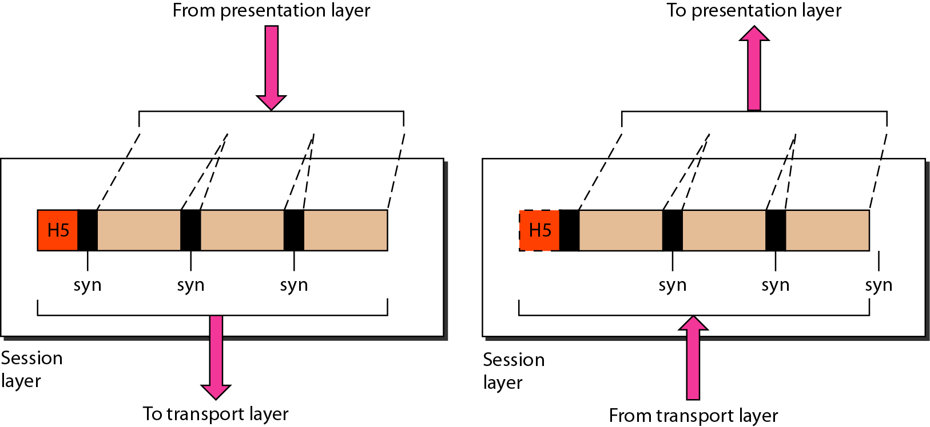
Figure 1.11 Session layer

Slide 37
Note
The session layer is responsible for dialog control and synchronization.

Slide 38
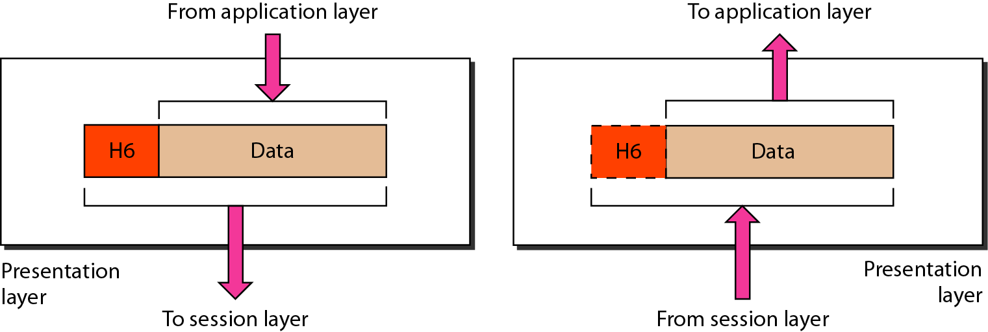
Figure 1.12 Presentation layer

Slide 39
Note
The presentation layer is responsible for translation, compression, and encryption.

Slide 40
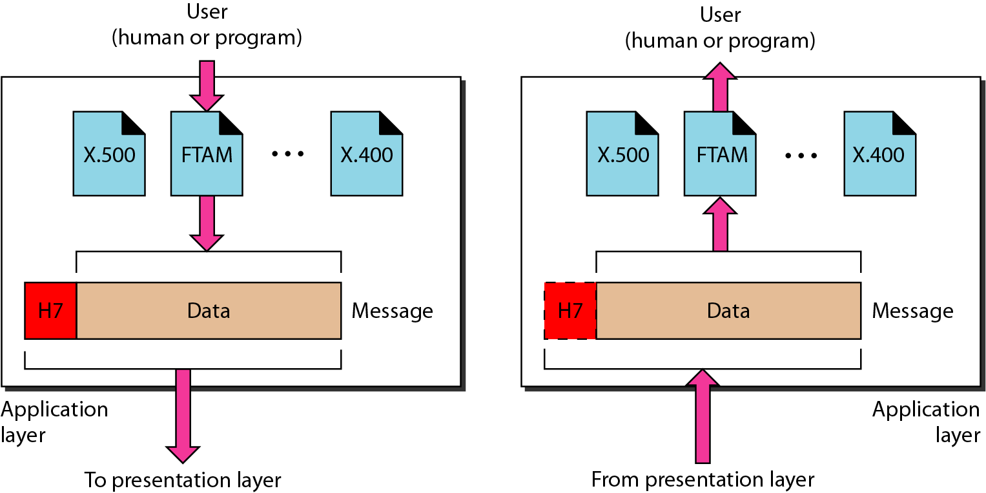
Figure 1.13 Application layer

Slide 41
Note
The application layer is responsible for providing services to the user.

Slide 42
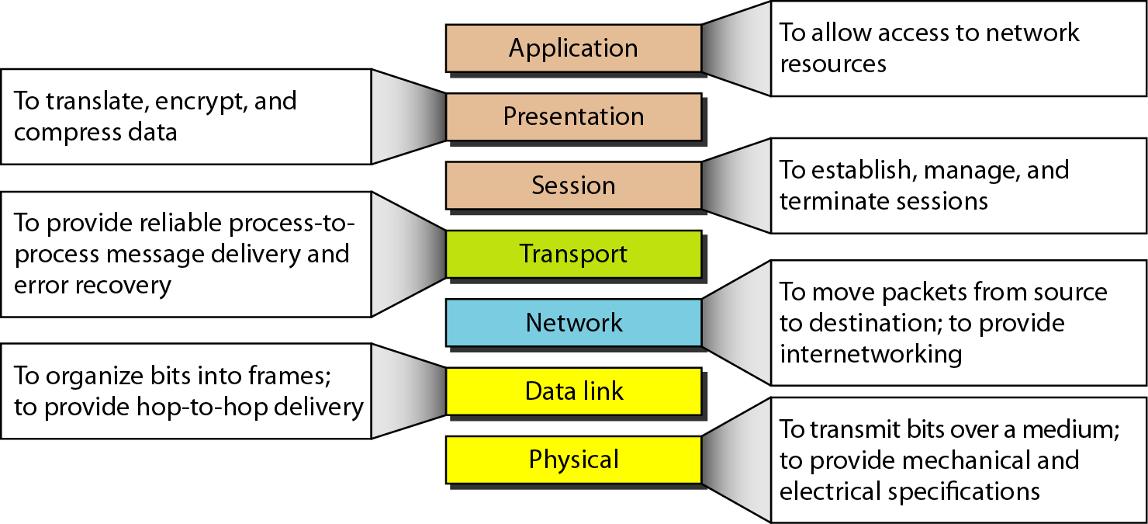
Figure 1.14 Summary of layers

Slide 43
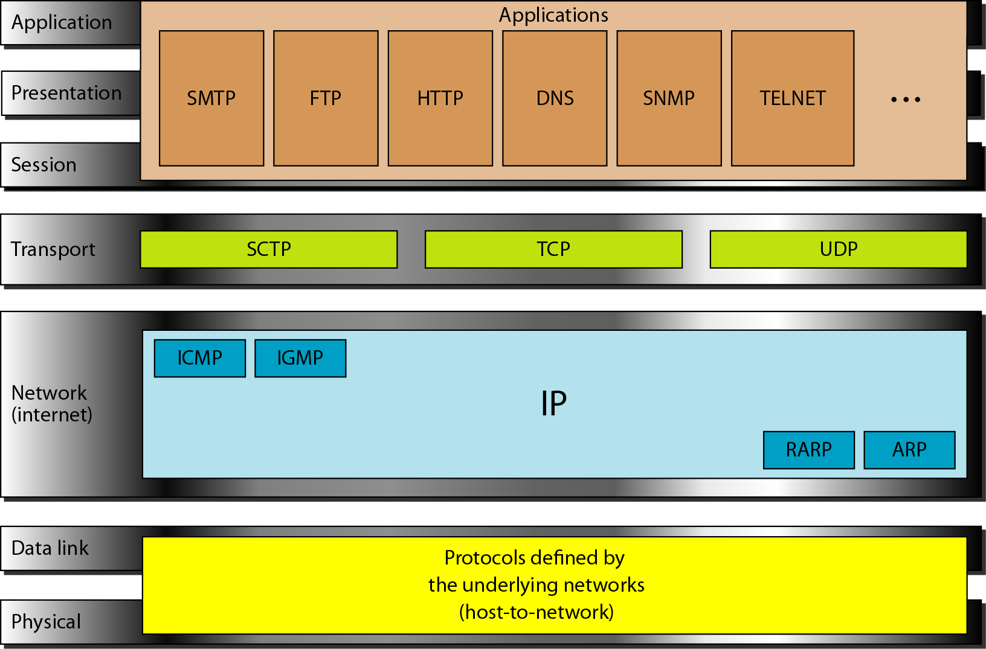
Figure 1.15 TCP/IP and OSI model

Slide 44
ADDRESSING
Four levels of addresses are used in an internet employing the TCP/IP protocols: physical, logical, port, and specific.

Slide 45
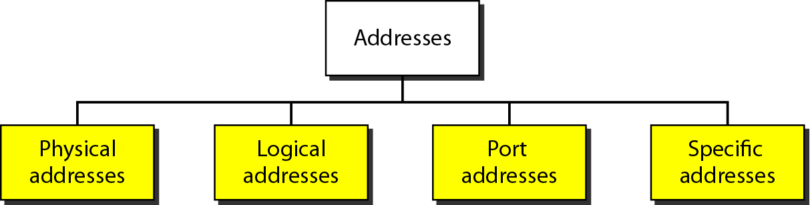
Figure 1.16 Addresses in TCP/IP

Slide 46
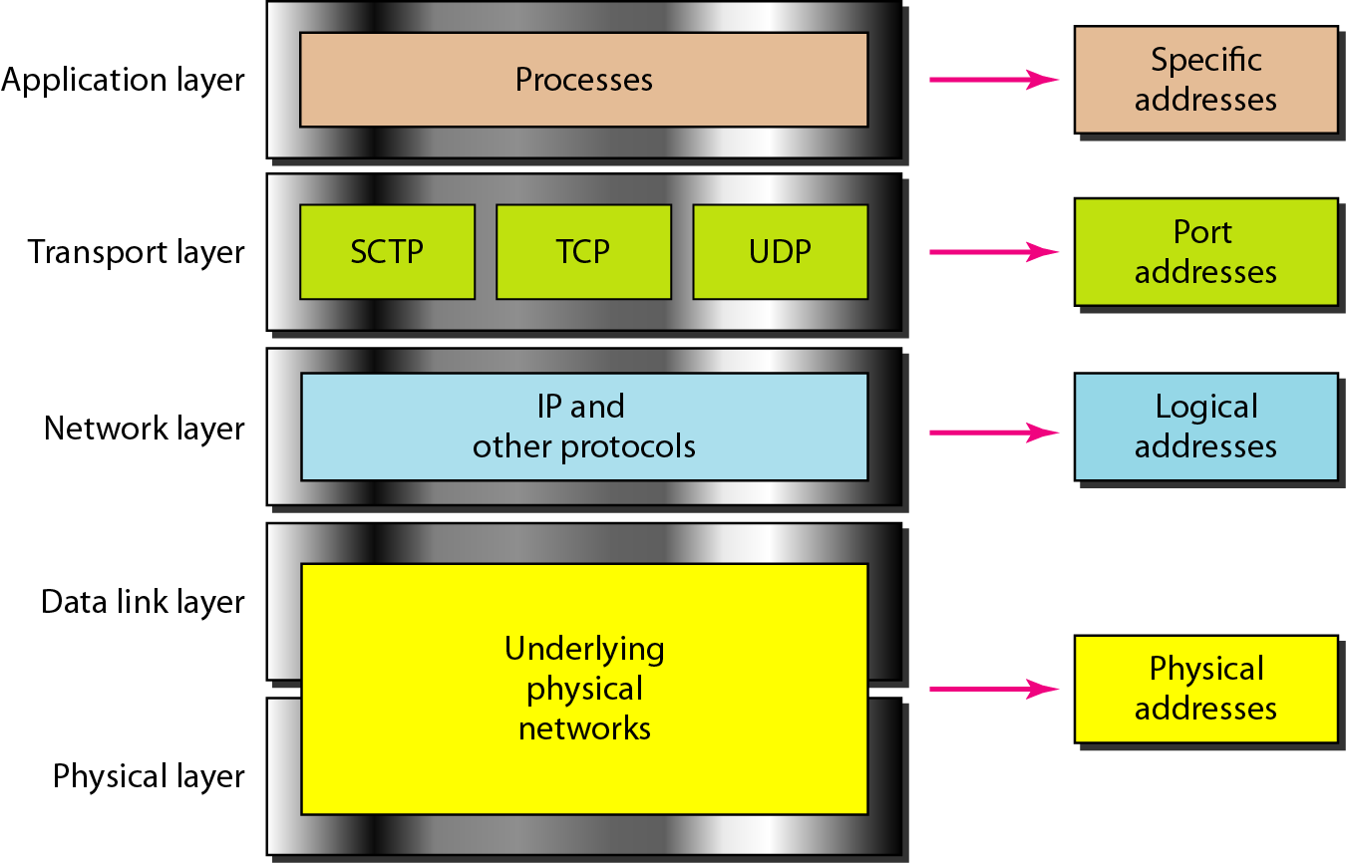
Figure 1.17 Relationship of layers and addresses in TCP/IP

Slide 47
Example 1.1
Figure 1.18 shows two computers communicating via the Internet. The sending computer is running three processes at this time with port addresses a, b, and c. The receiving computer is running two processes at this time with port addresses j and k. Process a in the sending computer needs to communicate with process j in the receiving computer. Note that although physical addresses change from hop to hop, logical and port addresses remain the same from the source to destination.

Slide 48
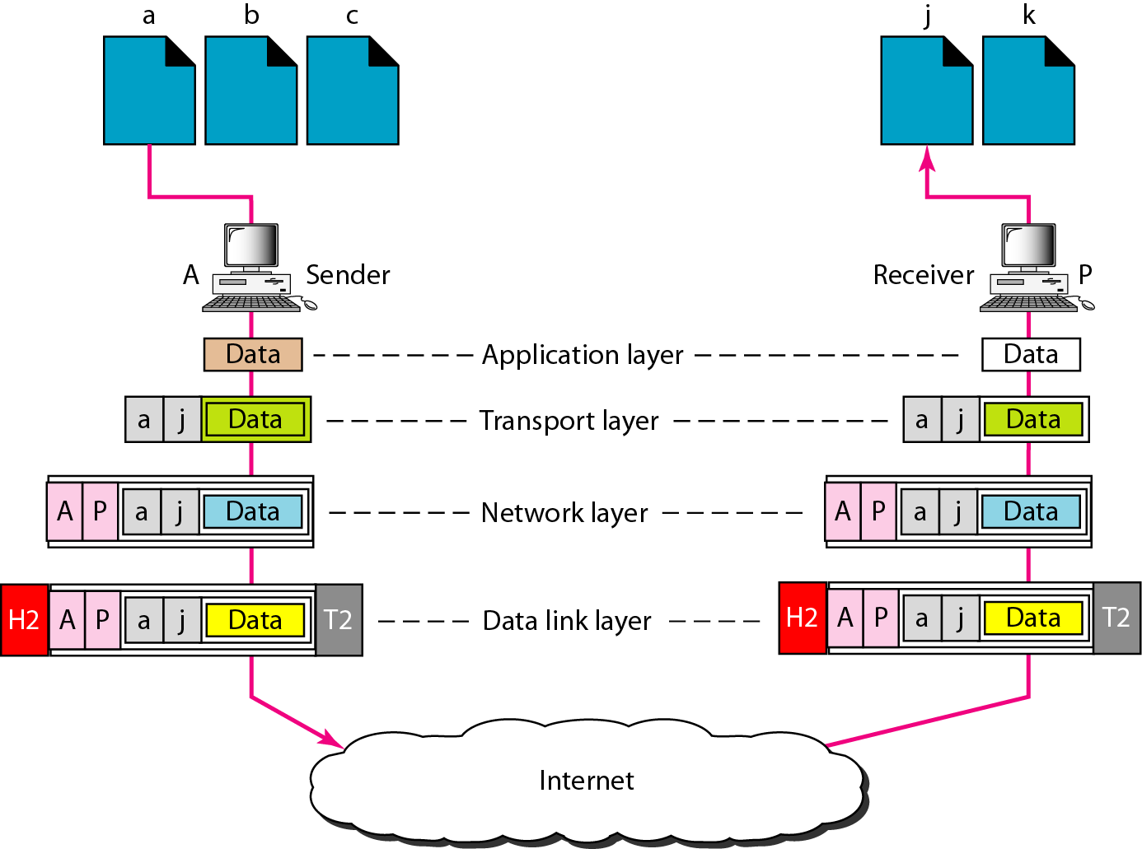
Figure 1.18 Port addresses

Slide 49
Note
The physical addresses will change from hop to hop,
but the logical addresses usually remain the same.

Slide 50
7 Application
NETWORK GOALS
The two main benefits of networking computers are…
Communications
Information can be distributed very quickly, such as email and video conferencing.
Saving Money
Resources such as information, software, and hardware can be shared.
CPUs and hard disks can be pooled together to create a more powerful machine.
6 Presentation
5 Session
4 Transport
3 Network
2 Data Link
1 Physical

Slide 51
7 Application
APPLICATIONS
A lot of things we take for granted are the result of computer networks.
Email
Chat
Web sites
Sharing of documents and pictures
Accessing a centralized database of information
Mobile workers
6 Presentation
5 Session
4 Transport
3 Network
2 Data Link
1 Physical

Slide 52
7 Application
NETWORK STRUCTURE
The subnet interconnects hosts.
Subnet
Carries messages from host to host. It is made up of telecommunication lines (i.e. circuits, channels, trunks) and switching elements (i.e. IMPs, routers).
Hosts
End user machines or computers.
Q: Is the host part of the subnet?
6 Presentation
5 Session
4 Transport
3 Network
2 Data Link
1 Physical

Slide 53
7 Application
NETWORK ARCHITECTURES
A set of layers and protocols is called the network architecture.
1. Protocol Hierarchies
Networks are organized as layers to reduce design complexity. Each layer offers services to the higher layers. Between adjacent layers is an interface.
Services – connection oriented and connectionless.
Interface – defines which primitives and services the lower layer will offer to the upper layer.
Primitives – operations such as request, indicate, response, confirm.
6 Presentation
5 Session
4 Transport
3 Network
2 Data Link
1 Physical

Slide 54
7 Application
SERVICES
Each layer provides services to the layer above it.
1. Terminologies
Entities – active elements in each layer (e.g. process, intelligent I/O chip).
Peer Entities – entities in the same layer on different machines.
Service Provider – Layer N.
Service User – Layer N + 1.
Service Access Points – places where layer N + 1 can access services offered by layer N.
6 Presentation
5 Session
4 Transport
3 Network
2 Data Link
1 Physical

Slide 55
7 Application
SERVICES
2. Connection-Oriented and Connectionless
Connection-Oriented – before data is sent, the service from the sending computer must establish a connection with the receiving computer.
Connectionless – data can be sent at any time by the service from the sending computer.
Q: Is downloading a music file from the Internet
connection-oriented or connectionless?
Q: Is email connection-oriented or connectionless?
6 Presentation
5 Session
4 Transport
3 Network
2 Data Link
1 Physical

Slide 56
7 Application
SERVICES
3. Service Primitives
Request – entity wants the service to do some work
Indicate – entity is to be informed about an event
Response – entity responds to an event
Confirm – entity is to be informed about its request
Sending Computer Receiving Computer
6 Presentation
5 Session
4 Transport
3 Network
2 Data Link
4 Transport
4 Transport
1 Physical
1. request
4. confirm
2. indicate
3. response
3 Network
3 Network

Slide 57
Networking Using Java
When computing devices such as laptops, desktops, servers, smartphones, and tablets and an eternally-expanding arrangement of IoT gadgets such as cameras, door locks, doorbells, refrigerators, audio/visual systems, thermostats, and various sensors are sharing information and data with each other is known as networking
In simple words, the term network programming or networking associates with writing programs that can be executed over various computer devices, in which all the devices are connected to each other to share resources using a network.
All the Java program communications over the network are done at the _________ layer.
The java.net package of the J2SE APIs comprises various classes and interfaces that execute the low-level communication features, enabling the user to formulate programs that focus on resolving the problem

Slide 58
Java Networking Terminologies
IP Address – An IP address is a unique address that distinguishes a device on the internet or a local network. IP stands for “Internet Protocol.” It comprises a set of rules governing the format of data sent via the internet or local network. IP Address is referred to as a logical address that can be modified. It is composed of octets. The range of each octet varies from 0 to 255.
Range of the IP Address – 0.0.0.0 to 255.255.255.255
For Example – 192.168.0.1
Port Number – A port number is a method to recognize a particular process connecting internet or other network information when it reaches a server. The port number is used to identify different applications uniquely. The port number behaves as a communication endpoint among applications. The port number is correlated with the IP address for transmission and communication among two applications. There are 65,535 port numbers, but not all are used every day.

Slide 59
Java Networking Terminologies
Protocol – A network protocol is an organized set of commands that define how data is transmitted between different devices in the same network. Network protocols are the reason through which a user can easily communicate with people all over the world and thus play a critical role in modern digital communications. For Example – TCP, FTP, POP, etc.
MAC Address – MAC address stands for Media Access Control address. It is a bizarre identifier that is allocated to a NIC (Network Interface Controller/ Card). It contains a 48 bit or 64-bit address, which is combined with the network adapter. MAC address can be in hexadecimal composition. In simple words, a MAC address is a unique number that is used to track a device in a network.

Slide 60
Java Networking Terminologies
A socket is one endpoint of a two-way communication connection between the two applications running on the network. The socket mechanism presents a method of inter-process communication (IPC) by setting named contact points between which the communication occurs. A socket is tied to a port number so that the TCP layer can recognize the application to which the data is intended to be sent.
Connection-oriented and connection-less protocol – In a connection-oriented service, the user must establish a connection before starting the communication. When the connection is established, the user can send the message or the information, and after this, they can release the connection. However, In connectionless protocol, the data is transported in one route from source to destination without verifying that the destination is still there or not or if it is ready to receive the message. Authentication is not needed in the connectionless protocol.
Example of Connection-oriented Protocol – Transmission Control Protocol (TCP)
Example of Connectionless Protocol – User Datagram Protocol (UDP)

Slide 61
Java Networking Classes
The java.net package of the Java programming language includes various classes that provide an easy-to-use means to access network resources. The classes covered in the java.net package are given as follows –
CacheRequest – The CacheRequest class is used in java whenever there is a need to store resources in ResponseCache. The objects of this class provide an edge for the OutputStream object to store resource data into the cache.
CookieHandler – The CookieHandler class is used in Java to implement a callback mechanism for securing up an HTTP state management policy implementation inside the HTTP protocol handler. The HTTP state management mechanism specifies the mechanism of how to make HTTP requests and responses.
CookieManager – The CookieManager class is used to provide a precise implementation of CookieHandler. This class separates the storage of cookies from the policy surrounding accepting and rejecting cookies. A CookieManager comprises a CookieStore and a CookiePolicy.

Slide 62
Java Networking Classes
DatagramPacket – The DatagramPacket class is used to provide a facility for the connectionless transfer of messages from one system to another. This class provides tools for the production of datagram packets for connectionless transmission by applying the datagram socket class.
InetAddress – The InetAddress class is used to provide methods to get the IP address of any hostname. An IP address is expressed by a 32-bit or 128-bit unsigned number. InetAddress can handle both IPv4 and IPv6 addresses.
Server Socket – The ServerSocket class is used for implementing system-independent implementation of the server-side of a client/server Socket Connection. The constructor for ServerSocket class throws an exception if it can’t listen on the specified port. For example – it will throw an exception if the port is already being used.
Socket – The Socket class is used to create socket objects that help the users in implementing all fundamental socket operations. The users can implement various networking actions such as sending, reading data, and closing connections. Each Socket object built using java.net.Socket class has been connected exactly with 1 remote host; for connecting to another host, a user must create a new socket object.

Slide 63
Java Networking Classes
DatagramSocket – The DatagramSocket class is a network socket that provides a connection-less point for sending and receiving packets. Every packet sent from a datagram socket is individually routed and delivered. It can further be practiced for transmitting and accepting broadcast information. Datagram Sockets is Java’s mechanism for providing network communication via UDP instead of TCP.
Proxy – A proxy is a changeless object and a kind of tool or method or program or system, which serves to preserve the data of its users and computers. It behaves like a wall between computers and internet users. A Proxy Object represents the Proxy settings to be applied with a connection.
URL – The URL class in Java is the entry point to any available sources on the internet. A Class URL describes a Uniform Resource Locator, which is a signal to a “resource” on the World Wide Web. A source can denote a simple file or directory, or it can indicate a more difficult object, such as a query to a database or a search engine.

Slide 64
Java Networking Classes
URLConnection – The URLConnection class in Java is an abstract class describing a connection of a resource as defined by a similar URL. The URLConnection class is used for assisting two distinct yet interrelated purposes. Firstly it provides control on interaction with a server(especially an HTTP server) than a URL class. Furthermore, with a URLConnection, a user can verify the header transferred by the server and can react consequently. A user can also configure header fields used in client requests using URLConnection

Slide 65
Java Networking Interfaces
The java.net package of the Java programming language includes various interfaces also that provide an easy-to-use means to access network resources. The interfaces included in the java.net package are as follows:
CookiePolicy – The CookiePolicy interface in the java.net package provides the classes for implementing various networking applications. It decides which cookies should be accepted and which should be rejected. In CookiePolicy, there are three pre-defined policy implementations, namely ACCEPT_ALL, ACCEPT_NONE, and ACCEPT_ORIGINAL_SERVER.
CookieStore – A CookieStore is an interface that describes a storage space for cookies. CookieManager combines the cookies to the CookieStore for each HTTP response and recovers cookies from the CookieStore for each HTTP request.

Slide 66
Java Networking Interfaces
FileNameMap – The FileNameMap interface is an uncomplicated interface that implements a tool to outline a file name and a MIME type string. FileNameMap charges a filename map ( known as a mimetable) from a data file.
SocketOption – The SocketOption interface helps the users to control the behavior of sockets. Often, it is essential to develop necessary features in Sockets. SocketOptions allows the user to set various standard options.
SocketImplFactory – The SocketImplFactory interface defines a factory for SocketImpl instances. It is used by the socket class to create socket implementations that implement various policies.
ProtocolFamily – This interface represents a family of communication protocols. The ProtocolFamily interface contains a method known as name(), which returns the name of the protocol family.

Slide 67
Socket Programming
Java Socket programming is practiced for communication between the applications working on different JRE. Sockets implement the communication tool between two computers using TCP. Java Socket programming can either be connection-oriented or connection-less. In Socket Programming, Socket and ServerSocket classes are managed for connection-oriented socket programming. However, DatagramSocket and DatagramPacket classes are utilized for connection-less socket programming.
A client application generates a socket on its end of the communication and strives to combine that socket with a server. When the connection is established, the server generates an object of socket class on its communication end. The client and the server can now communicate by writing to and reading from the socket.
The java.net.Socket class describes a socket, and the java.net.ServerSocket class implements a tool for the server program to host clients and build connections with them.

Slide 68

Thank you

